Slide 1
Financial Aid & College Financing
2012 - 2013

Slide 2
Agenda
Financial Aid & College Financing
Financial Aid Overview
Four Steps to Financial Aid
Types of Financial Aid
Saving for College
Reducing Expenses
Financing Options
Education Tax Credits & Deductions
Additional Resources

Slide 3
Financial Aid Overview
Financial Aid & College Financing – Tool Kit Page 2
Financial aid exists to help students pay for their college education
Everyone should apply for financial aid
Even if you do not think you will qualify
FAFSA is required for many scholarships and federal loans
Financial aid comes
from a variety of sources
Federal
State
Institutional (colleges)
Private

Slide 4
Step 1: Prepare
Financial Aid & College Financing – Tool Kit Page 3
Research colleges to learn about:
Costs and financial aid
Net Price Calculator - can be found on each school’s website
Deadlines
Requirements (CSS Profile or Institutional Forms)
Research and apply for outside scholarships
Use free searches only
Links at www.famemaine.com

Slide 5
Step 2: Apply
Financial Aid & College Financing – Tool Kit Page 4
Complete FREE Application for Federal Student Aid (FAFSA) at www.fafsa.gov
FAFSA is FREE – you don’t need to pay anyone to submit it
File on time – Submit the FAFSA as soon after January 1 as possible
Don’t wait until your taxes are complete – estimate and make changes later
Accurately provide name, DOB and social security number
Parental information – divorced/separated
Asset information
Save your confirmation page

Slide 6
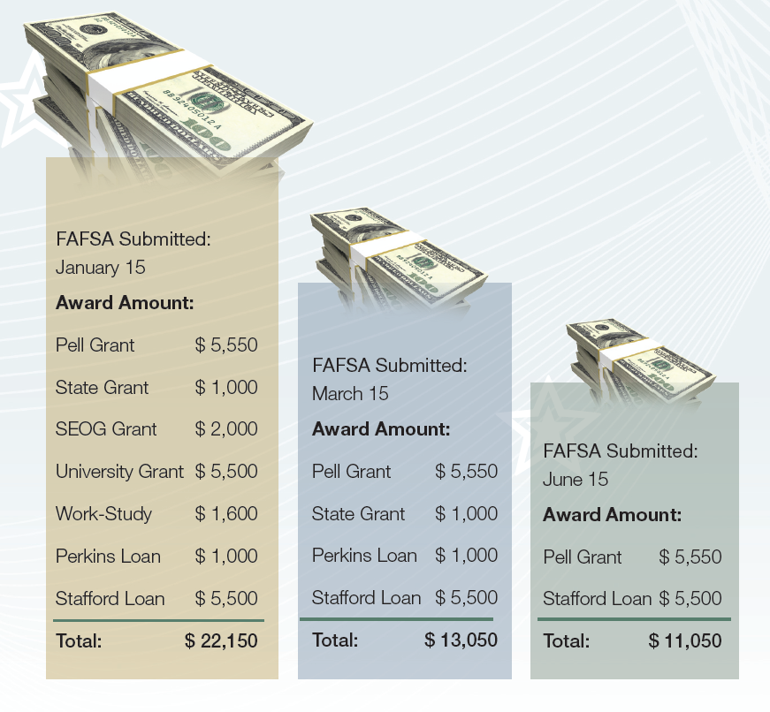
Deadlines Matter
Financial Aid & College Financing - Tool Kit Page 5

Slide 7
Step 3: Follow Up
Financial Aid & College Financing – Tool Kit Page 6
Student Aid Report (SAR)
Summary of FAFSA information
Review and correct errors at www.fafsa.gov
If you estimated your tax information, update once you have filed your return - use IRS match, if possible
FAFSA information and changes will be sent to the colleges electronically
Verification
Students randomly selected
Schools may send a verification request, or ask for other information – by mail or email
Be sure to meet your verification deadlines!

Slide 8
Your EFC
Financial Aid & College Financing – Tool Kit Page 7
Your Expected Family Contribution (EFC)
Calculated when you submit the FAFSA
Based upon your income and assets
Your EFC is…
Used as a measure of your family’s financial strength
Used by your school to calculate your financial aid
The same at each school that you apply to
Your EFC is not…
The amount of money your family will have to pay for school
The amount of financial aid you will receive

Slide 9
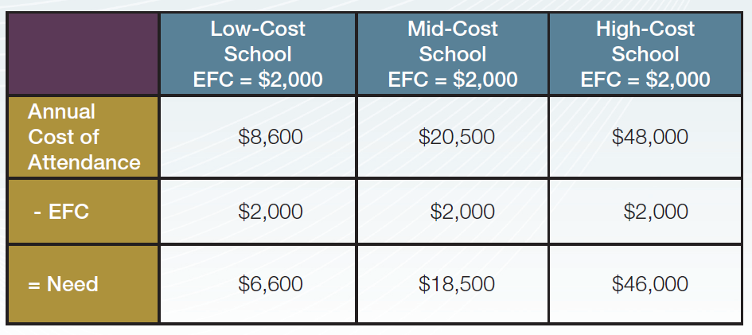
Examples of How Need is Determined
Financial Aid & College Financing – Tool Kit Page 7

Slide 10
Step 4: Respond
Financial Aid & College Financing – Tool Kit Page 8
The financial aid office will send or email you an award letter
You must be accepted for admission
Be sure to check your e-mail account
Review your award
Each financial aid package could be different
Compare types and amount of aid offered
Respond to colleges as necessary
Some types of aid require additional steps, such as loan applications and entrance counseling – respond quickly!
Notify colleges of your final decision
Provide any notifications of outside scholarships to the financial aid office

Slide 11
Special Circumstances
Financial Aid & College Financing – Tool Kit Page 8
Contact the Financial Aid Office directly to discuss any of the following:
Unemployment
Divorce or separation
Loss of income
Unusual medical expenses
Parent(s) attending college
Any financial change not reflected on the FAFSA

Slide 12
Types of Financial Aid
Financial Aid & College Financing – Tool Kit Page 9 & 10
Scholarships/Grants
Federal
State – including Maine
Institutional (colleges and universities)
Private
Work-study
Federal
Institutional
Loans
Federal Student (Direct Stafford) & Parent (Direct PLUS)
Institutional
Private/Alternative
Visit www.famemaine.com/education for more information about programs for Maine residents

Slide 13
Saving For College
Financial Aid & College Financing – Tool Kit Page 11
Section 529 Plan
tax-advantaged investment plan
available through most states
For more on Maine’s Section 529 Plan, the NextGen College Investing Plan®, visit www.nextgenplan.com
Coverdell Education Savings Accounts (ESA) –
up to $2,000 a year can be put aside for a education expenses. Qualified distributions are exempt from federal income tax and earnings are tax-free
Traditional and Roth IRA withdrawals
early IRA withdrawals, before age 59 ½, are allowed without the 10% penalty if funds are used for qualified education expenses.

Slide 14
Reducing Expenses
Financial Aid & College Financing – Tool Kit Page 12 & 13
Enrollment charges
Can you save on tuition?
Transfer and AP credits
Living expenses
On-campus or living at home?
Meal plans
Additional Costs
Travel expenses
Health insurance
Books and supplies
Buy books used, online or rent them
If you buy a computer, take advantage of student discounts
Popular Online Textbook Sites
www.amazon.com
www.barnesand noble.com
www.chegg.com
www.half.com
www.textbooks.com

Slide 15
Financing Options
Financial Aid & College Financing – Tool Kit Page 14
Savings
Work and save during the summer to cover expenses
Tuition Payment Plan
Make monthly payments to the college
Federal Parent PLUS Loan
Credit based, fixed interest rate
Alternative Loans
Credit based and typically require co-signer

Slide 16
Education Tax Credits & Deductions
Financial Aid & College Financing – Tool Kit Page 15
Educational Opportunity Tax Credit
Maine tax credit for student loan payments made by degree earners who live, work and pay taxes in Maine upon graduation. Visit www.opportunitymaine.org
American Opportunity Tax Credit
Federal income tax credit of up to $2,500 per student
Lifetime Learning Tax Credit
Federal income tax credit of up to $2,000 per taxpayer
Student Loan Interest Deduction
Federal tax deduction of up to $2,500 in interest as an adjustment to income

Slide 17
Additional Resources
Financial Aid & College Financing – Tool Kit Page 16
Numerous web-based resources exist
Talk with your school counselor & financial aid office
FAME
www.famemaine.com/education or 1-800-228-3734
College Goal Maine – Various locations and dates in January and early February
Line by line FAFSA completion with help from experts
www.famemaine.com/education

Slide 18
Questions?
Financial Aid & College Financing
Finance Authority of Maine
5 Community Drive
P.O. Box 949
Augusta, ME 04332
1-800-228-3734
education@famemaine.com
www.famemaine.com

